Slide 1
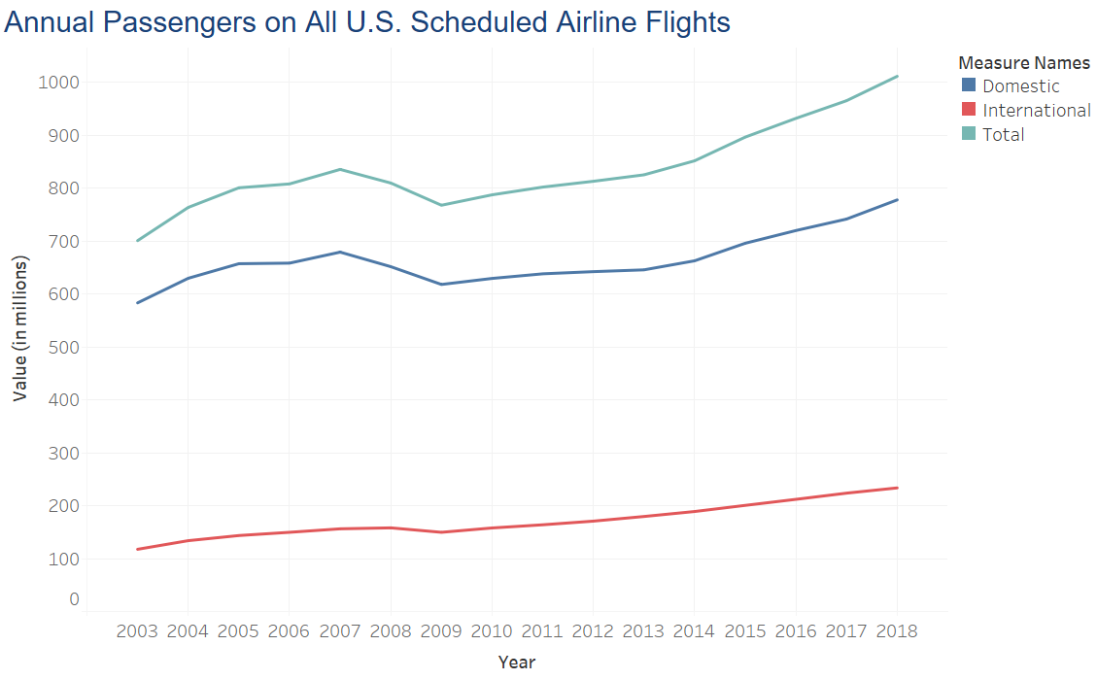
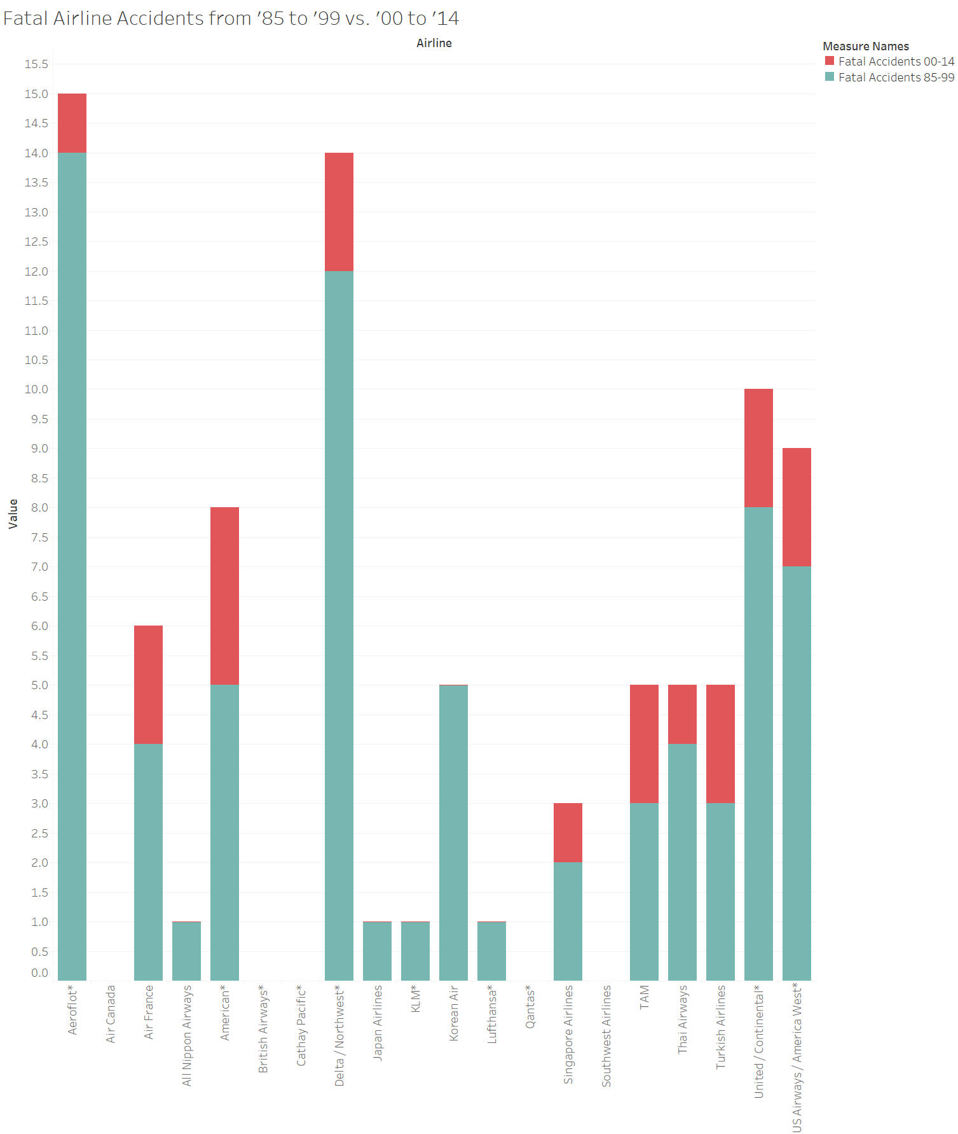
Airline Safety
Is flight becoming less safe?
Are people afraid to fly?
40% of people have a fear of flying
2.5% of people have a clinical phobia of flying
Are people still flying?
Even though many people are afraid to fly, more and more people fly every year.
Is it true that it is less safe?
NO!
Flying is safer than ever before. Even with increasing number of flights we see fewer fatal accidents.
Sources:
1. Schaaff, S. V. (2019, October 12). Lots of Americans have a fear of flying. There are
ways to overcome the anxiety disorder. Retrieved from www.washingtonpost.com
2. Annual Passengers on All U.S. Scheduled Airline Flights (Domestic & International) and
2/20/2020 Airline Safety
Foreign Airline Flights to and from the United States, 2003-2018. (n.d.). Retrieved from www.bts.dot.gov

